Slide 1
01 009 D0 and 07 1147 DAY0

Slide 2
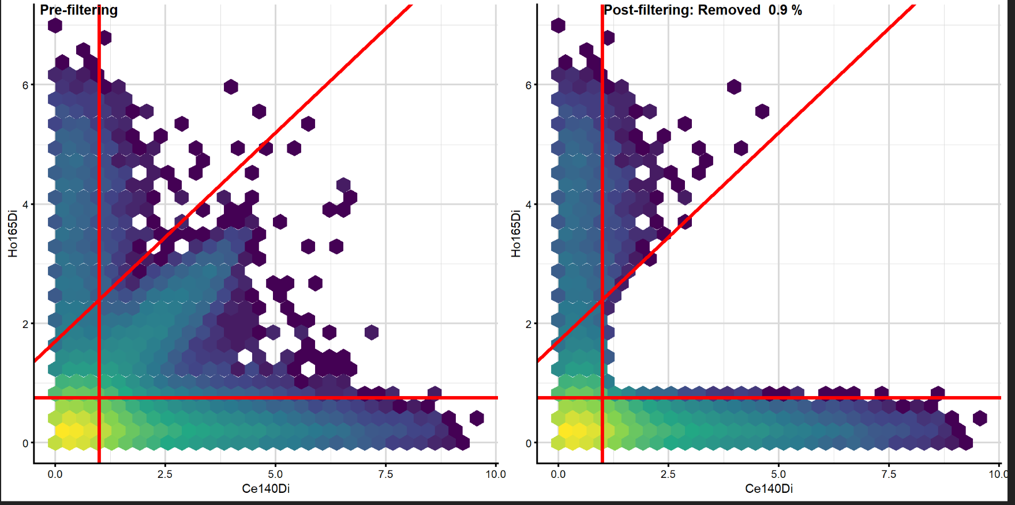
IFNg vs Ce140Di (beads only): Before and after suggested cut

Slide 3
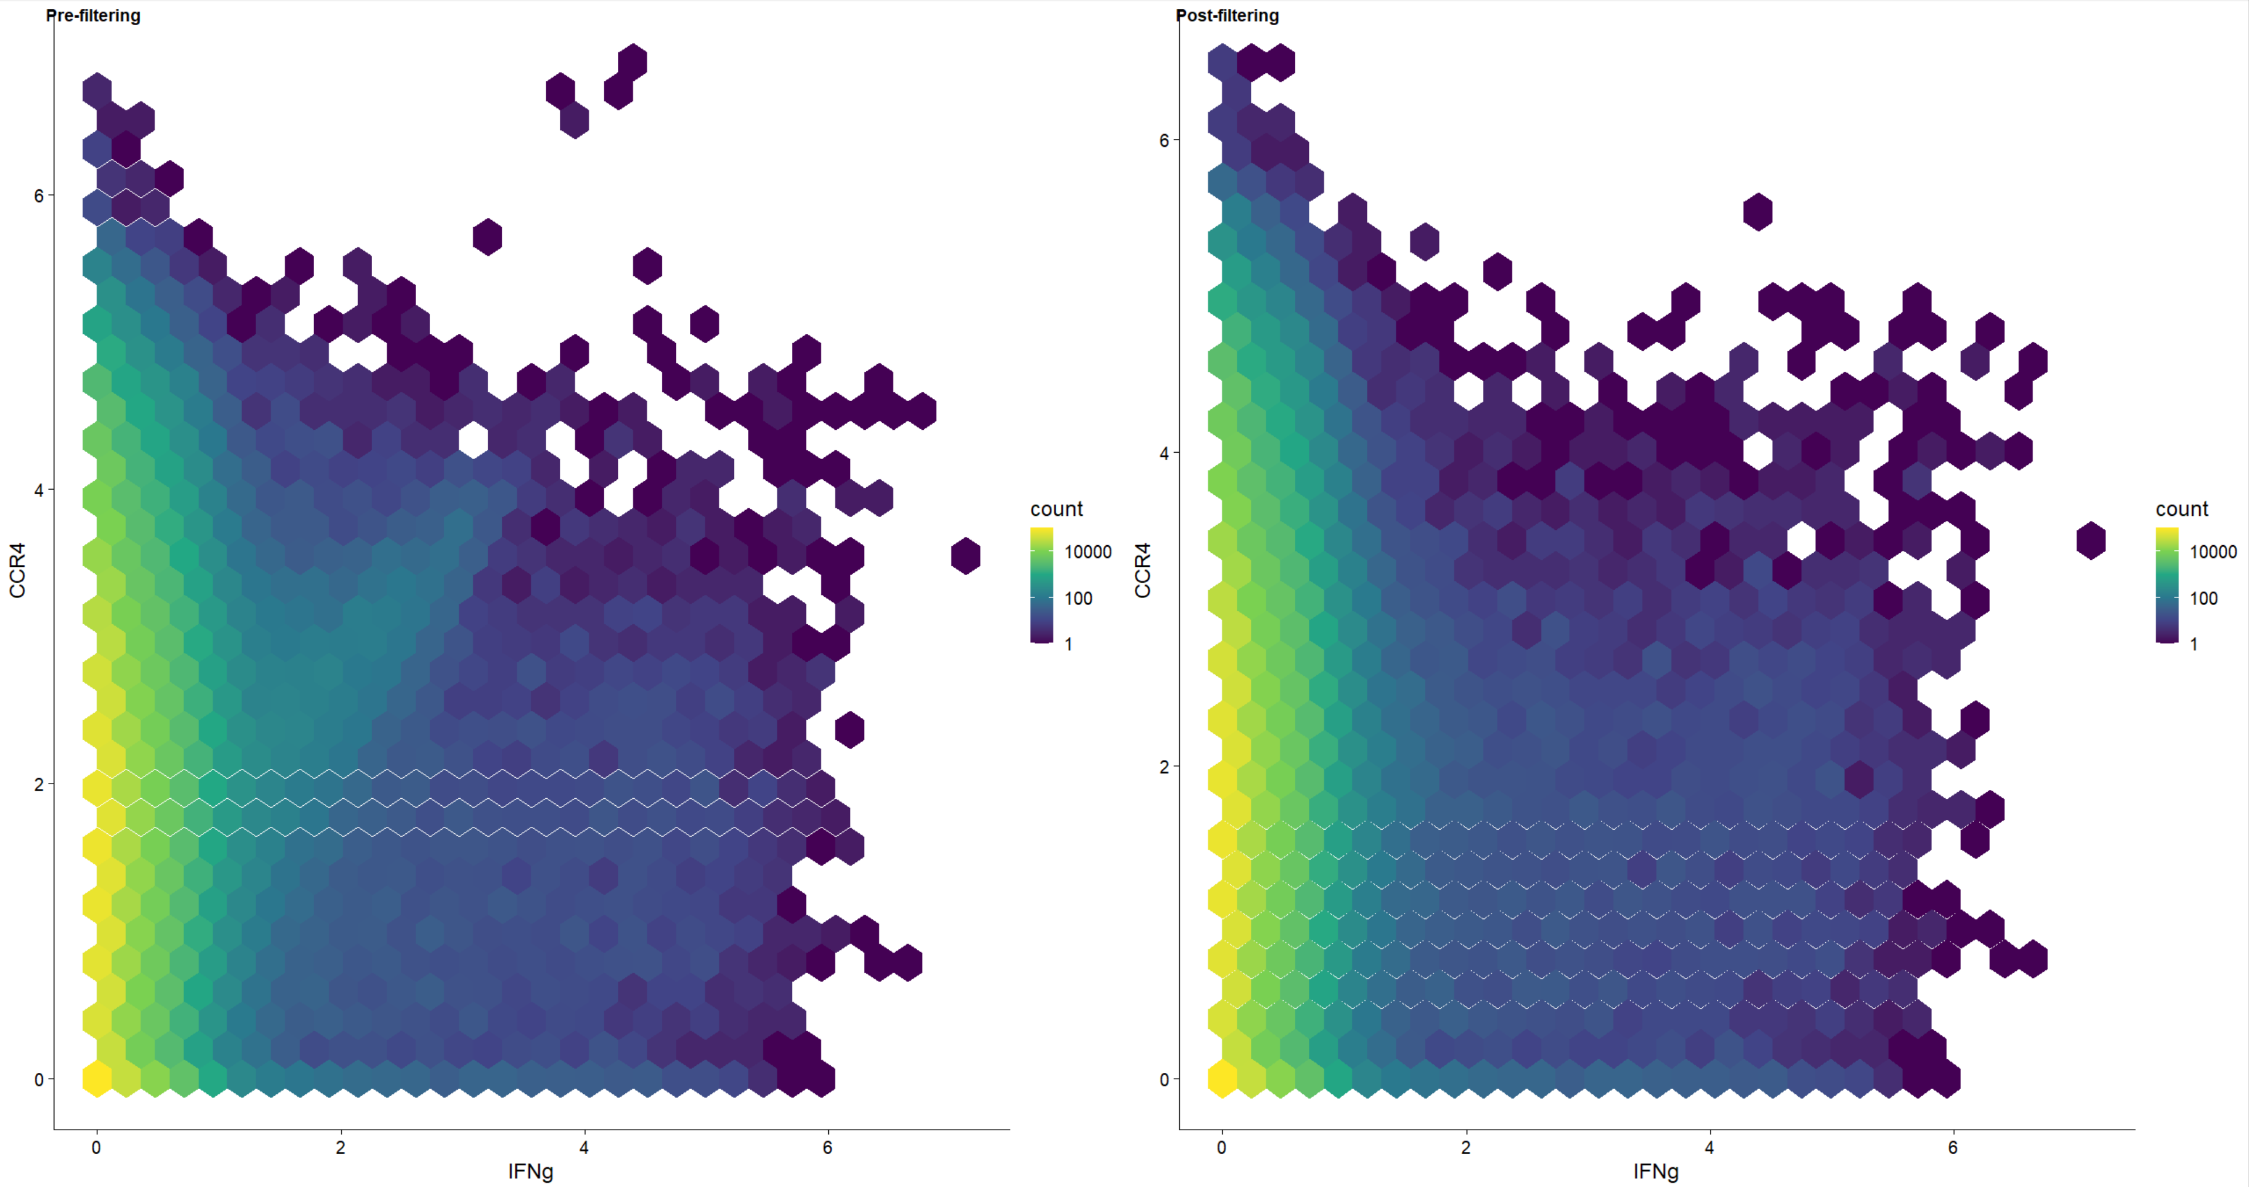
CCR4 vs IFNg: Before and after

Slide 4
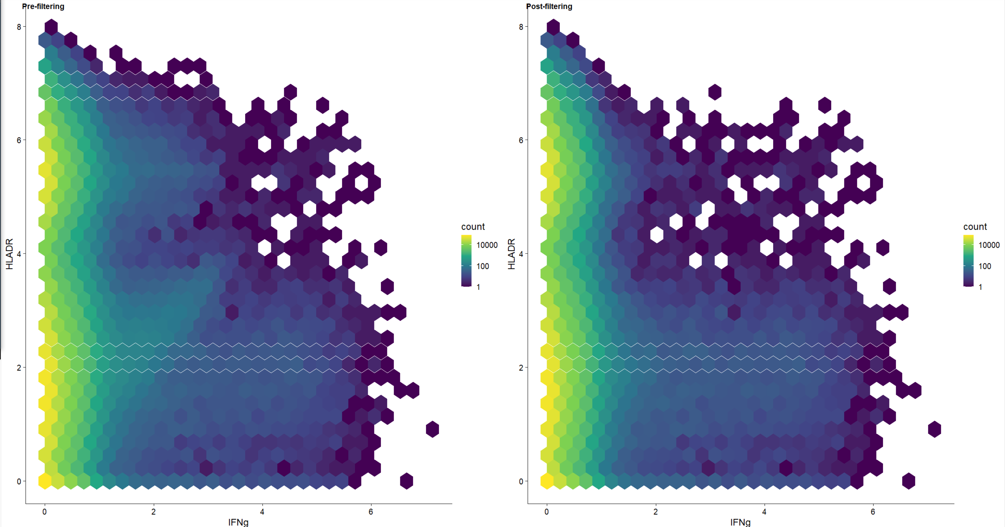
HLADR vs IFNg: Before and after

Slide 5
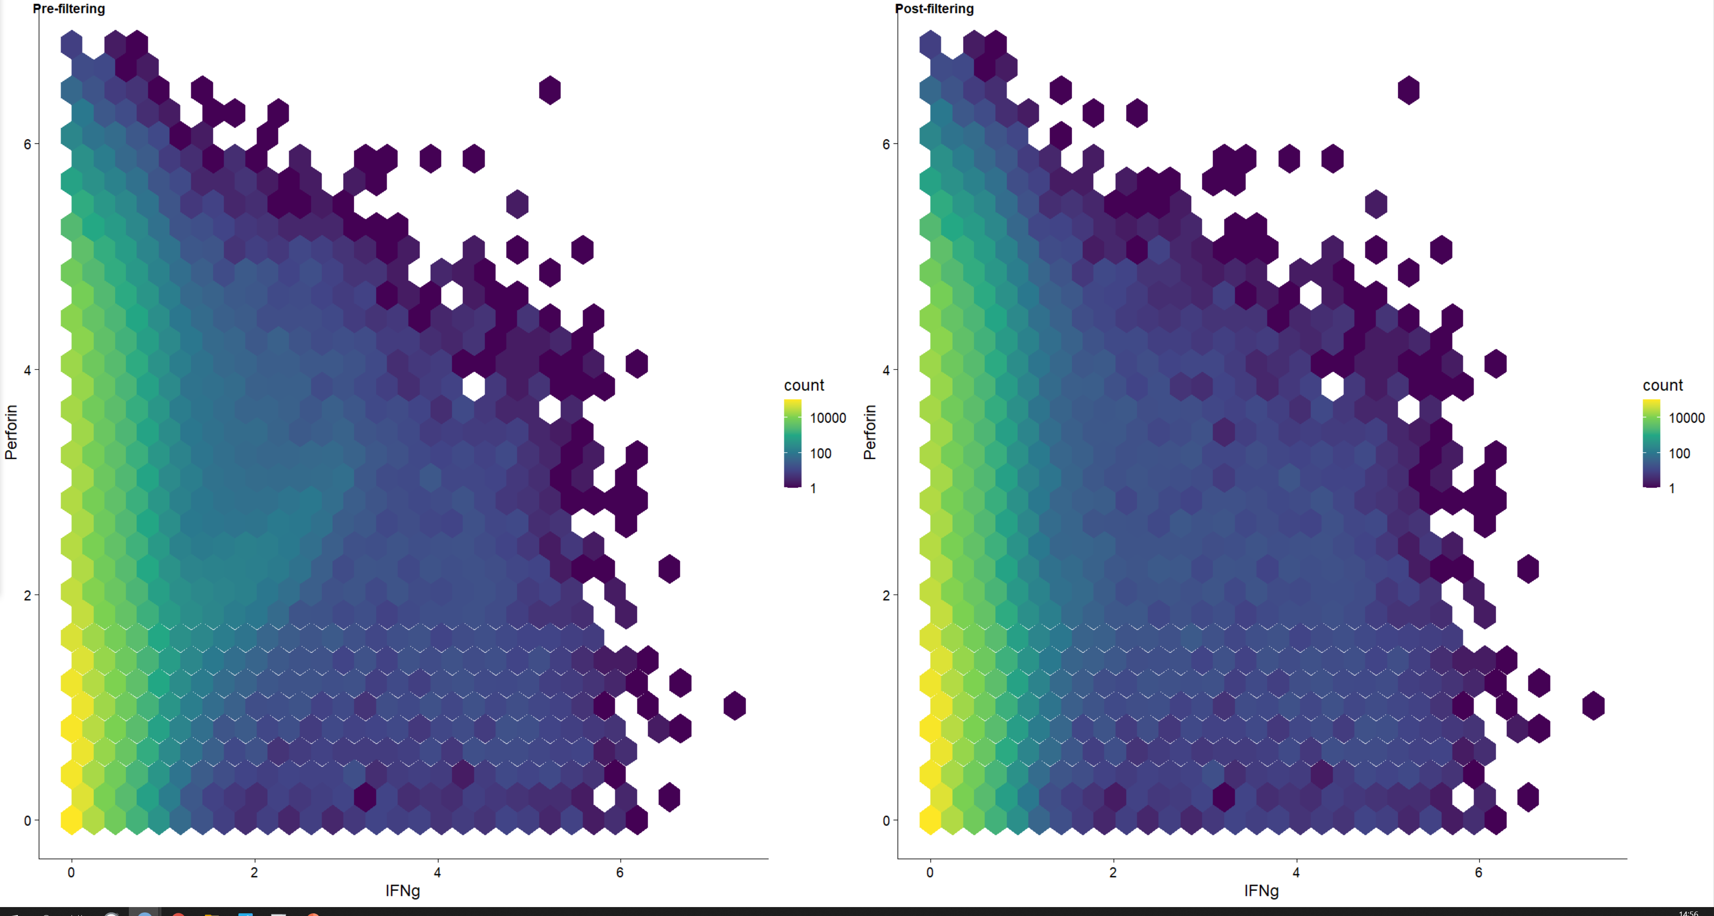
Perforin vs IFNg: Before and after

